Slide 1


School of Computing
Department of Computer Science & Engineering
Course.Name: Data Warehousing and Data Mining
Course.Code :1151CS114 – Slot:S2 &S3
Category :Program Core

Slide 2

Course Outcomes
CO Nos. | Course Outcomes | K Level
CO1 | Explain and identify the subject areas for which a data warehouse is to be built. | K2
CO2 | Design Multidimensional data model for data warehouse and analyze the market needs by applying the suitable OLAP operations. | K3
CO3 | Explain the concept of Data mining system and apply the various preprocessing techniques on large dataset. | K2
CO4 | Apply Association rule mining, classification and clustering techniques to discover various mining patterns. | K3
CO5 | Apply clustering techniques in various data mining applications | K3

Slide 3
Unit V -Syallabus
UNIT VCLUSTERING, APPLICATIONS AND TRENDS IN DATA MINING L-8
Cluster Analysis
Types of Data
Categorization of Major Clustering Methods
K- means
Partitioning Methods
Hierarchical Methods
Outlier Analysis
Data Mining Applications
Social Impacts of Data Mining
Mining WWW
Mining Text Database
Mining Spatial Databases
Case Studies (Simulation Tool).

Slide 4
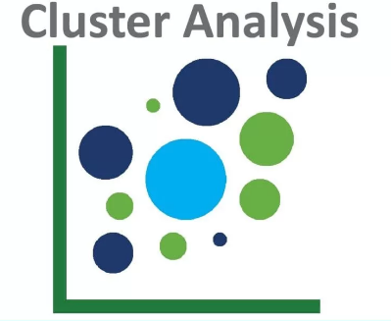

Slide 5
Cluster Analysis
Cluster: A collection of data objects
similar (or related) to one another within the same group
dissimilar (or unrelated) to the objects in other groups
Cluster analysis (or clustering, data segmentation, …)
Finding similarities between data according to the characteristics found in the data and grouping similar data objects into clusters
Unsupervised learning: no predefined classes (i.e., learning by observations vs. learning by examples: supervised)

Slide 6
Cluster Analysis-Requirements
Scalability
Ability to deal with different types of attributes
Discovery of clusters with arbitrary shape
Requirements for domain knowledge to determine input parameters
Ability to deal with noisy data
Incremental clustering and insensitivity to input order
Capability of clustering high-dimensionality data
Constraint-based clustering
Interpretability and usability

Slide 7
Methods of clustering
Partitioning based Method
Hierarchical Method
Fuzzy based
Density-based Method
Model-Based Method

Slide 8
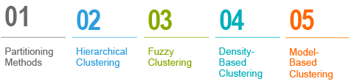
Types of Clustering

Slide 9
Partitioning based Method
The partition algorithm divides data into many subsets.
Let’s assume the partitioning algorithm builds partition of data as k and n is objects are present in the database. Hence each partition will be represented as k ≤ n.
This gives an idea that the classification of the data is in k groups, which can be shown below

Slide 10
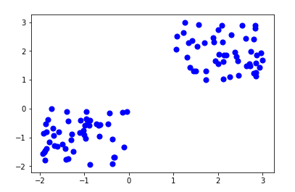
Partitioning based Method

Slide 11
Density Based Method
These algorithms produce clusters in a determined location based on the high density of data set participants.
It aggregates some range notion for group members in clusters to a density standard level.
Such processes can perform less in detecting the group’s Surface areas.

Slide 12
Fuzzy clustering
Fuzzy clustering is also known as soft method. Standard clustering approaches produce partitions (K-means, PAM), in which each observation belongs to only one cluster. This is known as hard clustering.
In Fuzzy clustering, items can be a member of more than one cluster. Each item has a set of membership coefficients corresponding to the degree of being in a given cluster. The Fuzzy c-means method is the most popular fuzzy clustering algorithm.

Slide 13
Hierarchical Method
The method will create a hierarchical decomposition of a given set of data objects.
Based on how the hierarchical decomposition is formed, we can classify hierarchical methods. This method is given as follows
Agglomerative Approach
Divisive Approach

Slide 14
Hierarchical Method
Agglomerative Approach is also known as Button-up Approach. Here we begin with every object that constitutes a separate group. It continues to fuse objects or groups close together
Divisive Approach is also known as the Top-Down Approach. We begin with all the objects in the same cluster.
This method is rigid, i.e., it can never be undone once a fusion or division is completed

Slide 15
Model-Based Method
This method uses a hypothesized model based on probability distribution. By clustering the density function, this method locates the clusters.
It reflects the data points’ spatial distribution.

Slide 16
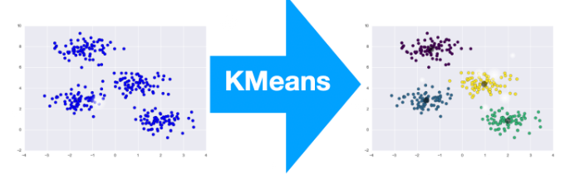
K-Mean Clustering

Slide 17
About K-Mean Clustering
K-Means clustering intends to partition n objects into k clusters in which each object belongs to the cluster with the nearest mean. This method produces exactly k different clusters of greatest possible distinction. The best number of clusters k leading to the greatest separation (distance) is not known as a priori and must be computed from the data. The objective of K-Means clustering is to minimize total intra-cluster variance, or, the squared error function:

Slide 18
K- means Clustering
Recall the first property of clusters – it states that the points within a cluster should be similar to each other. So, our aim here is to minimize the distance between the points within a cluster.
There is an algorithm that tries to minimize the distance of the points in a cluster with their centroid – the k-means clustering technique
K-means is a centroid-based algorithm, or a distance-based algorithm, where we calculate the distances to assign a point to a cluster. In K-Means, each cluster is associated with a centroid.
The main objective of the K-Means algorithm is to minimize the sum of distances between the points and their respective cluster centroid.

Slide 19
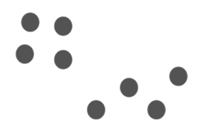
K- means Clustering
Let’s now take an example to understand how K-Means actually works:
We have these 8 points and we want to apply k-means to create clusters for these points. Here’s how we can do it.
Step 1: Choose the number of clusters k
The first step in k-means is to pick the number of clusters, k.

Slide 20
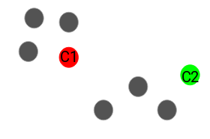
Step 2: Select k random points from the data as centroids
Next, we randomly select the centroid for each cluster. Let’s say we want to have 2 clusters, so k is equal to 2 here. We then randomly select the centroid:
Here, the red and green circles represent the centroid for these clusters.

Slide 21
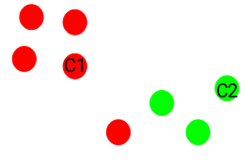
K- means Clustering
Step 3: Assign all the points to the closest cluster centroid
Once we have initialized the centroids, we assign each point to the closest cluster centroid:
Here you can see that the points which are closer to the red point are assigned to the red cluster whereas the points which are closer to the green point are assigned to the green cluster.

Slide 22
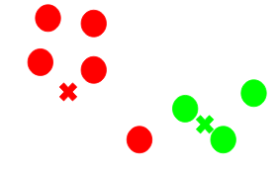
K- means Clustering
Step 4: Recompute the centroids of newly formed clusters
Now, once we have assigned all of the points to either cluster, the next step is to compute the centroids of newly formed clusters:
Here, the red and green crosses are the new centroids.

Slide 23
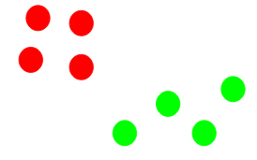
K- means Clustering
Step 5: Repeat steps 3 and 4
We then repeat steps 3 and 4
The step of computing the centroid and assigning all the points to the cluster based on their distance from the centroid is a single iteration.

Slide 24
K- means Clustering Algorithm
Input:
K: The number of clusters in which the dataset has to be divided
D: A dataset containing N number of objects
Output:
A dataset of K clusters
Method:
Randomly assign K objects from the dataset(D) as cluster centres(C)
(Re) Assign each object to which object is most similar based upon mean values.
Update Cluster means, i.e., Recalculate the mean of each cluster with the updated values.
Repeat Step 4 until no change occurs.

Slide 25
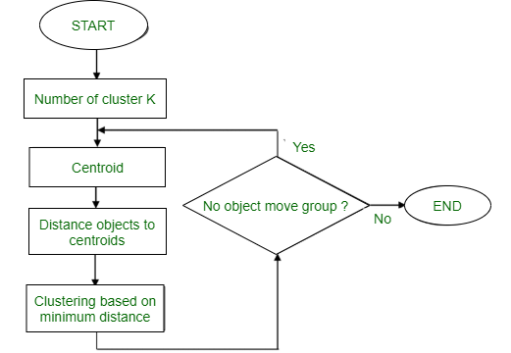
K- means Clustering Algorithm

Slide 26
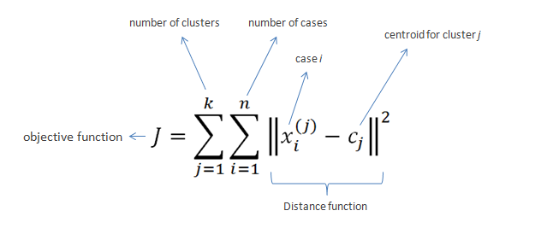
formula

Slide 27
Example:
Example: Suppose we want to group the visitors to a website using just their age as follows:
16, 16, 17, 20, 20, 21, 21, 22, 23, 29, 36, 41, 42, 43, 44, 45, 61, 62, 66
Initial Cluster:
K=2 Centroid(C1) = 16 [16] Centroid(C2) = 22 [22]
Note: These two points are chosen randomly from the dataset.
Iteration-1:
C1 = 16.33 [16, 16, 17] C2 = 37.25 [20, 20, 21, 21, 22, 23, 29, 36, 41, 42, 43, 44, 45, 61, 62, 66]
Iteration-2:
C1 = 19.55 [16, 16, 17, 20, 20, 21, 21, 22, 23] C2 = 46.90 [29, 36, 41, 42, 43, 44, 45, 61, 62, 66]

Slide 28
Example:
Iteration-3:
C1 = 20.50 [16, 16, 17, 20, 20, 21, 21, 22, 23, 29] C2 = 48.89 [36, 41, 42, 43, 44, 45, 61, 62, 66]
Iteration-4:
C1 = 20.50 [16, 16, 17, 20, 20, 21, 21, 22, 23, 29] C2 = 48.89 [36, 41, 42, 43, 44, 45, 61, 62, 66]
No change Between Iteration 3 and 4, so we stop.
Therefore we get the clusters (16-29) and (36-66) as 2 clusters we get using K Mean Algorithm.

Slide 29
Algorithms
Clusters the data into k groups where k is predefined. Select k points at random as cluster centers. Assign objects to their closest cluster center according to the Euclidean distance function. Calculate the centroid or mean of all objects in each cluster. Repeat steps 2, 3 and 4 until the same points are assigned to each cluster in consecutive rounds.

Slide 30
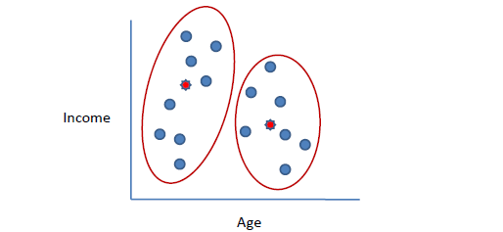
Continued….

Slide 31
Continued..
K-Means is relatively an efficient method. However, we need to specify the number of clusters, in advance and the final results are sensitive to initialization and often terminates at a local optimum. Unfortunately there is no global theoretical method to find the optimal number of clusters. A practical approach is to compare the outcomes of multiple runs with different k and choose the best one based on a predefined criterion. In general, a large k probably decreases the error but increases the risk of overfitting.

Slide 32
Definition and its types
A hierarchical clustering method works by grouping data objects into a hierarchy or “tree” of clusters.
Types of Hierarchical Methods
Agglomerative versus Divisive Hierarchical Clustering
Distance Measures in Algorithmic Methods
BIRCH: Multiphase Hierarchical Clustering Using Clustering Feature Trees
Chameleon: Multiphase Hierarchical Clustering Using Dynamic Modeling

Slide 33
Agglomerative versus Divisive Hierarchical Clustering
An agglomerative hierarchical clustering method uses a bottom-up strategy. It typically starts by letting each object form its own cluster and iteratively merges clusters into larger and larger clusters, until all the objects are in a single cluster or certain termination conditions are satisfied.
A divisive hierarchical clustering method employs a top-down strategy. It starts by placing all objects in one cluster, which is the hierarchy’s root. It then divides the root cluster into several smaller subclusters, and recursively partitions those clusters into smaller ones.

Slide 34
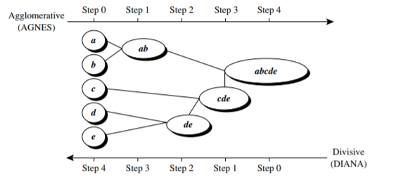
Example- Agglomerative versus divisive hierarchical clustering.
Figure shows the application of AGNES (AGglomerative NESting), an agglomerative hierarchical clustering method, and DIANA (DIvisive ANAlysis),
a divisive hierarchical clustering method, on a data set of five objects, {a,b,c,d, e}.

Slide 35
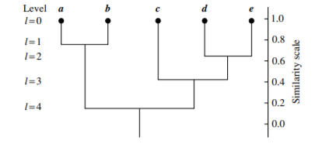
Dendrogram- commonly used to represent the process of hierarchical clustering.

Slide 36
DISTANCE MEASURES IN ALGORITHMIC METHODS
When an algorithm uses the minimum distance, d_{min}(C_{i} ,C_{j}), to measure the distance between clusters, it is sometimes called a nearest-neighbor clustering algorithm.
If the clustering process is terminated when the distance between nearest clusters exceeds a user-defined threshold, it is called a single-linkage algorithm.
An agglomerative hierarchical clustering algorithm that uses the minimum distance measure is also called a minimal spanning tree algorithm,
where a spanning tree of a graph is a tree that connects all vertices, and a minimal spanning tree is the one with the least sum of edge weights.

Slide 37
DISTANCE MEASURES IN ALGORITHMIC METHODS
When an algorithm uses the maximum distance, dmax(Ci ,Cj), to measure the distance between clusters, it is sometimes called a farthest-neighbor clustering algorithm
If the clustering process is terminated when the maximum distance between nearest clusters exceeds a user-defined threshold, it is called a complete-linkage algorithm.
The mean distance is the simplest to compute, the average distance is advantageous in that it can handle categoric as well as numeric data.

Slide 38
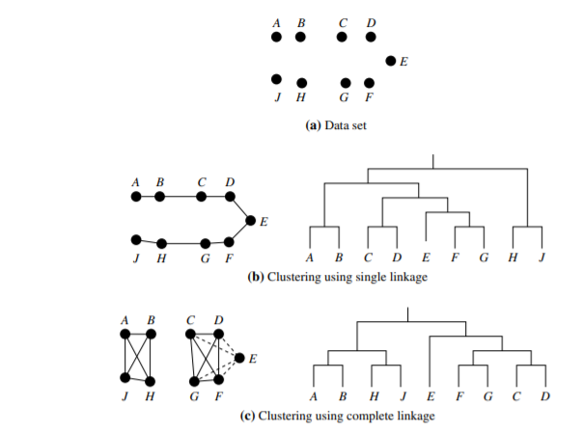
Example : Single versus complete linkages.

Slide 39
BIRCH: MULTIPHASE HIERARCHICAL CLUSTERING USING CLUSTERING FEATURE TREES
Balanced Iterative Reducing and Clustering using Hierarchies (BIRCH) is designed for clustering a large amount of numeric data by integrating hierarchical clustering (at the initial microclustering stage) and other clustering methods such as iterative partitioning (at the later macroclustering stage).
It overcomes the two difficulties in agglomerative clustering methods: (1) scalability and (2) the inability to undo what was done in the previous step.
BIRCH uses the notions of clustering feature to summarize a cluster, and clustering feature tree (CF-tree) to represent a cluster hierarchy.
These structures help the clustering method achieve good speed and scalability in large or even streaming databases

Slide 40

Continued…
Consider a cluster of n d-dimensional data objects or points. The clustering feature (CF) of the cluster is a 3-D vector summarizing information about clusters of objects. It is defined as

Slide 41

continued….
Clustering feature are additive. That is, for two disjoint clusters, C₁ and C₂, with the clustering features CF₁ = (n₁,LS₁,SS₁)and CF₂ = (n₂,LS₂,SS₂), respectively, the clustering feature for the cluster that formed by merging C₁ and C₂ is simply
CF₁ + CF₂ = (n₁ + n₂,LS₁ + LS₂,SS₁ + SS₂).

Slide 42
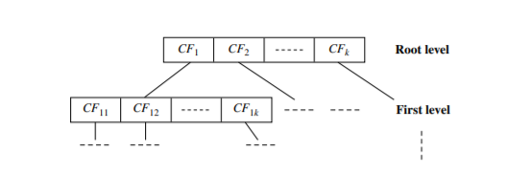
Cf tree
A CF-tree is a height-balanced tree that stores the clustering features for a hierarchical clustering

Slide 43
CHAMELEON: MULTIPHASE HIERARCHICAL CLUSTERING USING DYNAMIC MODELING
Chameleon is a hierarchical clustering algorithm that uses dynamic modeling to determine the similarity between pairs of clusters. In Chameleon, cluster similarity is assessed based on (1) how well connected objects are within a cluster and (2) the proximity of clusters.
Chameleon uses a k-nearest-neighbor graph approach to construct a sparse graph, where each vertex of the graph represents a data object, and there exists an edge between two vertices (objects) if one object is among the k-most similar objects to the other.
The edges are weighted to reflect the similarity between objects. Chameleon uses a graph partitioning algorithm to partition the k-nearest-neighbor graph into a large number of relatively small subclusters such that it minimizes the edge cut.

Slide 44
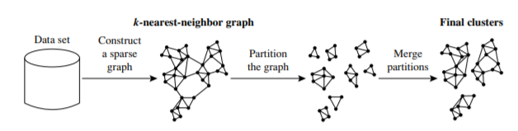
Continued..

Slide 45
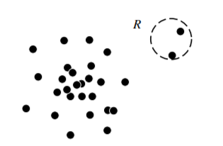
OUTLIERS AND OUTLIER ANALYSIS

Slide 46
Types of Outliers
Global Outliers - it deviates significantly from the rest of the data set
Contextual Outliers- it deviates significantly with respect to a specific context of the object.
Two attributes
Contextual attributes-
Behavioral attributes:
Collective Outliers- the objects as a whole deviate significantly from the entire data set. Importantly, the individual data objects may not be outliers.

Slide 47
Challenges of Outlier Detection
Modeling normal objects and outliers effectively. Outlier detection quality highly depends on the modeling of normal objects and outliers.
Application-specific outlier detection. Technically, choosing the similarity/distance measure and the relationship model to describe data objects is critical in outlier detection.
Handling noise in outlier detection
Understandability.

Slide 48

MINING TEXT DATA

Slide 49
About text mining…
Text mining is an interdisciplinary field that draws on information retrieval, data mining, machine learning, statistics, and computational linguistics.
A substantial portion of information is stored as text such as news articles, technical papers, books, digital libraries, email messages, blogs, and web pages

Slide 50
Information Retrieval
Information retrieval deals with the retrieval of information from a large number of text-based documents.
Some of the database systems are not usually present in information retrieval systems because both handle different kinds of data.
Examples of information retrieval system include −
Online Library catalogue system
Online Document Management Systems
Web Search Systems etc.

Slide 51
Basic Measures for Text Retrieval
to check the accuracy of a system when it retrieves a number of documents on the basis of user's input.
Let the set of documents relevant to a query be denoted as {Relevant} and the set of retrieved document as {Retrieved}.
The set of documents that are relevant and retrieved can be denoted as {Relevant} ∩ {Retrieved}.

Slide 52
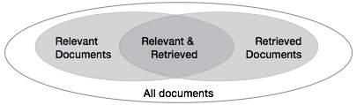
Venn diagram

Slide 53
fundamental measures
There are three fundamental measures for assessing the quality of text retrieval −
Precision
Recall
F-score

Slide 54
Precision
Precision is the percentage of retrieved documents that are in fact relevant to the query.
Precision can be defined as −
Precision= |{Relevant} ∩ {Retrieved}| / |{Retrieved}|
Recall
Recall is the percentage of documents that are relevant to the query and were in fact retrieved.
Recall is defined as −
Recall = |{Relevant} ∩ {Retrieved}| / |{Relevant}|
F-score
F-score is the commonly used trade-off.
The information retrieval system often needs to trade-off for precision or vice versa.
F-score is defined as harmonic mean of recall or precision as follows −
F-score = recall x precision / (recall + precision) / 2

Slide 55
Mining World Wide Web
web mining can be organized into three main areas:
web content mining,
web structure mining, and
web usage mining

Slide 56
Web content mining
Web content mining analyses web content such as text, multimedia data, and structured data.
This is done to understand the content of web pages, provide scalable and informative keyword-based page indexing, entity/concept resolution, web page relevance and ranking, web page content summaries, and other valuable information related to web search and analysis.
Web pages can reside either on the surface web or on the deep Web.
The surface web is that portion of the Web that is indexed by typical search engines.
The deep Web (or hidden Web) refers to web content that is not part of the surface web

Slide 57
Web structure mining
Web structure mining is the process of using graph and network mining theory and methods to analyse the nodes and connection structures on the Web.
It extracts patterns from hyperlinks, where a hyperlink is a structural component that connects a web page to another location.
It can also mine the document structure within a page
e.g., analyse the treelike structure of page structures to describe HTML or XML tag usage

Slide 58
Web usage mining
Web usage mining is the process of extracting useful information (e.g., user click streams) from server logs.
It finds patterns related to general or particular groups of users;
understands users’ search patterns, trends, and associations; and predicts what users are looking for on the Internet.

Slide 59
Challenges in Web Mining
The web is too huge − The size of the web is very huge and rapidly increasing. This seems that the web is too huge for data warehousing and data mining.
Complexity of Web pages − The web pages do not have unifying structure. They are very complex as compared to traditional text document. There are huge amount of documents in digital library of web. These libraries are not arranged according to any particular sorted order.
Web is dynamic information source − The information on the web is rapidly updated. The data such as news, stock markets, weather, sports, shopping, etc., are regularly updated.
Diversity of user communities − The user community on the web is rapidly expanding. These users have different backgrounds, interests, and usage purposes. There are more than 100 million workstations that are connected to the Internet and still rapidly increasing.
Relevancy of Information − It is considered that a particular person is generally interested in only small portion of the web, while the rest of the portion of the web contains the information that is not relevant to the user and may swamp desired results.

Slide 60
Mining Web page layout structure
The basic structure of the web page is based on the Document Object Model (DOM).
The DOM structure refers to a tree like structure where the HTML tag in the page corresponds to a node in the DOM tree.
We can segment the web page by using predefined tags in HTML.

Slide 61
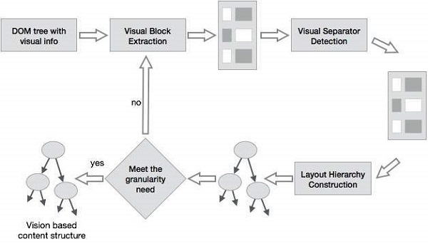
Vision-based page segmentation (VIPS)

Slide 62
Vision-based page segmentation (VIPS)
The purpose of VIPS is to extract the semantic structure of a web page based on its visual presentation.
Such a semantic structure corresponds to a tree structure. In this tree each node corresponds to a block.
A value is assigned to each node. This value is called the Degree of Coherence. This value is assigned to indicate the coherent content in the block based on visual perception.
The VIPS algorithm first extracts all the suitable blocks from the HTML DOM tree. After that it finds the separators between these blocks.
The separators refer to the horizontal or vertical lines in a web page that visually cross with no blocks.
The semantics of the web page is constructed on the basis of these blocks.

